Slide 1

Making Amends
SS.7.C.3.5 Explain the constitutional amendment process.
Explaining the constitutional amendment process

Slide 2

Review: What is a constitution?
Provides a framework for government
Outlines responsibilities and powers
Limits government authority
Protects the rights of the people
Think of a constitution as a rule book for government.
Rule Book

Slide 3
What is an amendment?
Amendments are changes or additions to a document.
Why is having a formal amendment process important?
Notes:
Have students discuss the amendment process question in small groups. Circulate throughout the room and prompt students to consider when our constitution was written, who it was written by, and why having procedures is important.
An amendment process was included in Article V of the U.S. Constitution so that, when needed, changes and additions could be made to the Constitution in the future.

Slide 4

Article 5
Notes:
Have students discuss the amendment process question in small groups. Circulate throughout the room and prompt students to consider when our constitution was written, who it was written by, and why having procedures is important.
An amendment process was included in Article V of the U.S. Constitution so that, when needed, changes and additions could be made to the Constitution in the future.

Slide 5
Type into the chat: Why is it important to be able to change the Constitution?
Notes:
Have students discuss the amendment process question in small groups. Circulate throughout the room and prompt students to consider when our constitution was written, who it was written by, and why having procedures is important.
An amendment process was included in Article V of the U.S. Constitution so that, when needed, changes and additions could be made to the Constitution in the future.

Slide 6


Is it in the Constitution?
Give a thumbs up or thumbs down if you think each proposal passed or failed as an amendment to the U.S. Constitution!

Slide 7
Thumbs up or down?
1947: the income tax maximum for an individual should not exceed 25%;

Slide 8
Is it in the Constitution?
1971: American citizens should have the alienable right to an environment free of pollution

Slide 9
Is it in the Constitution?
1876: The forbidding of religious leaders from occupying a governmental office or receiving federal funding

Slide 10
Is it in the Constitution?
1916: All acts of war should be put to a national vote. Anyone voting yes had to register as a volunteer for service in the United States Army

Slide 11
Is it in the Constitution?
1914: Finding divorce to be illegal

Slide 12
Did you know?
Approximately 10,000 amendments have been proposed in Congress since 1789.
The success rate of an amendment to become part of the U.S. Constitution is less than 1%.
Notes:
www.constitutionfacts.com

Slide 13

Did you know?
India has the longest written Constitution of any sovereign country in the world
444 Articles, 12 schedules, 94 amendments
U.S. Constitution is the shortest
7 Articles and 27 Amendments

Slide 14
Steps in The Amendment process

Slide 15

Two Part Process
There are two parts to the constitutional amendment process. See Article 5 of the US Constitution.
Article V
Part One: Proposal Process
Part Two: Ratification Process

Slide 16

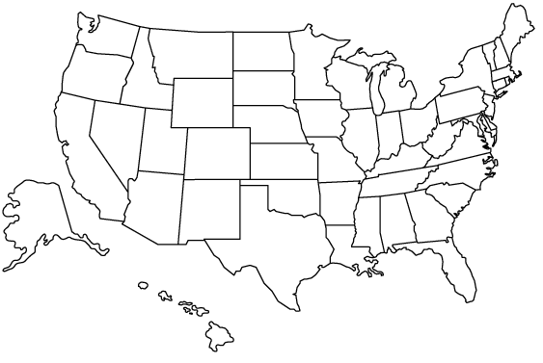
Proposing Amendments to the U.S. Constitution
Consent of 2/3 of both houses of Congress
Constitutional convention (never been used)
2/3 of the legislatures of the states call a convention
2/3
2/3
Notes:
Emphasize the numbers needed to propose an amendment to the U.S. Constitution and how difficult it would be to come to a consensus on a proposed amendment. Amending the U.S. Constitution is a difficult process, but a formal process is important when making changes that impact the entire nation (including the structure of government, rights of the people, powers and responsibilities of government officials, etc.)
Amendments have many sources – individuals, special interest groups, caucuses*, Congress people, etc.
*A meeting of the members of a legislative body who are members of a particular political party, to select candidates or decide policy. Example: Balanced Budget Amendment Caucus http://crfb.org/blogs/balanced-budget-amendment-caucus-launches
https://www.archives.gov/federal-register/constitution/
http://www.aoc.gov/us-capitol-building

Slide 17
Approving (Ratifying) Amendments to the U.S. Constitution
Ratified by ¾ of state legislatures
Ratified by ¾ of constitutional conventions
3/4
3/4

Slide 18
Amending the U.S. Constitution
Proposal
Ratification
Congress
3/4
2/3
state legislatures
OR
OR
2/3
3/4
Constitutional
convention
Constitutional
convention

Slide 19
Checking for Understanding
Which is the last step in amending the U.S. Constitution?
The voters approve the amendment in a national election.
The president signs the amendment in a public ceremony.
Three-fourths of the state legislatures ratify the amendment.
Two-thirds of both houses of Congress ratify the amendment.

